Slide 1
LEVERAGING ML APPROACHES FOR DIABETES PREDICTION AND ANALYSIS
Research Questions
Model Performance Comparison?
Exploratory Data Insights?
Objectives
To develop machine models
To evaluate and compare the performance
To provide actionable insights

Slide 2
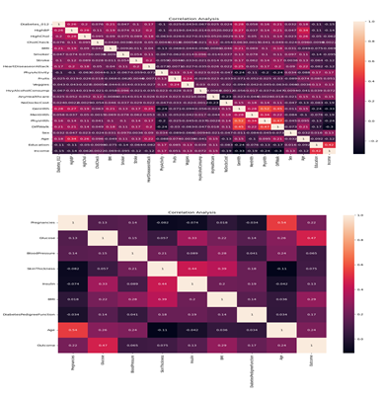
Insights from Exploratory Data Analysis
Correlation Heatmap for 1st and 2nd Dataset
Key Observations:
BRFSS Dataset:
Strong correlations between variables like BMI, Age, Physical Health (PhysHlth), and Diabetes progression.
High cholesterol and high blood pressure (HighBP, HighChol) are positively correlated with diabetes risk, especially for Diabetes 012 (target variable).
Pima Indians Dataset:
BMI and Glucose levels are strongly correlated with Diabetes outcome.
Pregnancies show a weaker correlation, but it still impacts Diabetes prediction.
Both datasets show that age and BMI are key predictors of diabetes risk, while Physical Health and General Health (GenHlth) are also important but to a lesser extent.

Slide 3
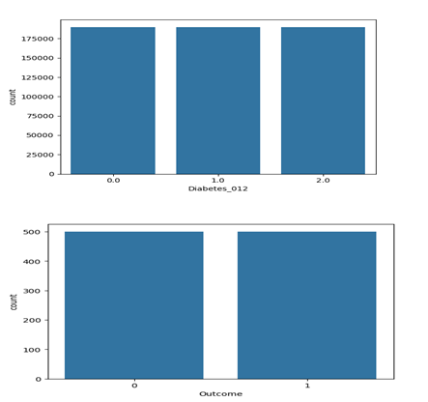
Preprocessing of Data
Balancing the 1st&2nd dataset
Key Observations:
Both datasets were initially imbalanced, with a higher proportion of non-diabetic cases.
Post-SMOTE, the datasets are now balanced with approximately equal representation across all diabetes classes, ensuring improved model performance and fairness.

Slide 4
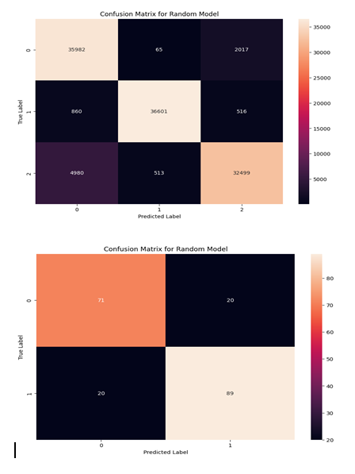
Model Evaluation Visuals
Confusion Matrix for Random Forest on 1st&2nd datasets
General Performance or Insights:
The Random Forest model handles the BRFSS dataset with more success due to the larger dataset and better handling of class imbalances.
The Pima Indians dataset shows better balanced performance, though a few misclassifications still persist, especially for non-diabetic cases.

Slide 5
Model Performance and Insights on Diabetes Prediction
Results of Model Performance on two datasets (BRFSS 2015 Diabetes and Pima Indians Diabetes)
Key Findings:
Random Forest Model:
Best Performance: Achieved high accuracy (92%) on the BRFSS 2015 Diabetes dataset and 80% on the Pima Indians Diabetes dataset.
Strengths: Balanced performance across classes, handled class imbalances effectively with SMOTE.
Recommendation: Most reliable model for predicting diabetes progression.
XGBoost Model:
Performance: 83% accuracy on BRFSS 2015 Diabetes and 79% on Pima Indians Diabetes.
Strengths: Efficient and fast training, good at identifying non-diabetic cases.
Weaknesses: Struggled with recall for diabetic cases, requiring further tuning.
Recommendation: Suitable as a secondary model with optimization to improve recall for diabetics.
SVM Model:
Worst Performance: Lowest accuracy (52% on BRFSS and 72% on Pima Indians).
Weaknesses: Poor classification for diabetic and pre-diabetic classes, especially with class imbalances.
Recommendation: Should be avoided due to poor performance.
Insights:
Factors like BMI, physical activity, age, and blood pressure are strongly linked to diabetes progression.
SMOTE helped balance the datasets, improving model performance, particularly for Random Forest and XGBoost.
Conclusion:
Random Forest is the most suitable model for diabetes prediction, with XGBoost showing promise after further tuning. SVM should be avoided due to its poor performance.
Future work should focus on optimizing the models, especially to handle class imbalances and improve recall for diabetic cases.

